Slide 1


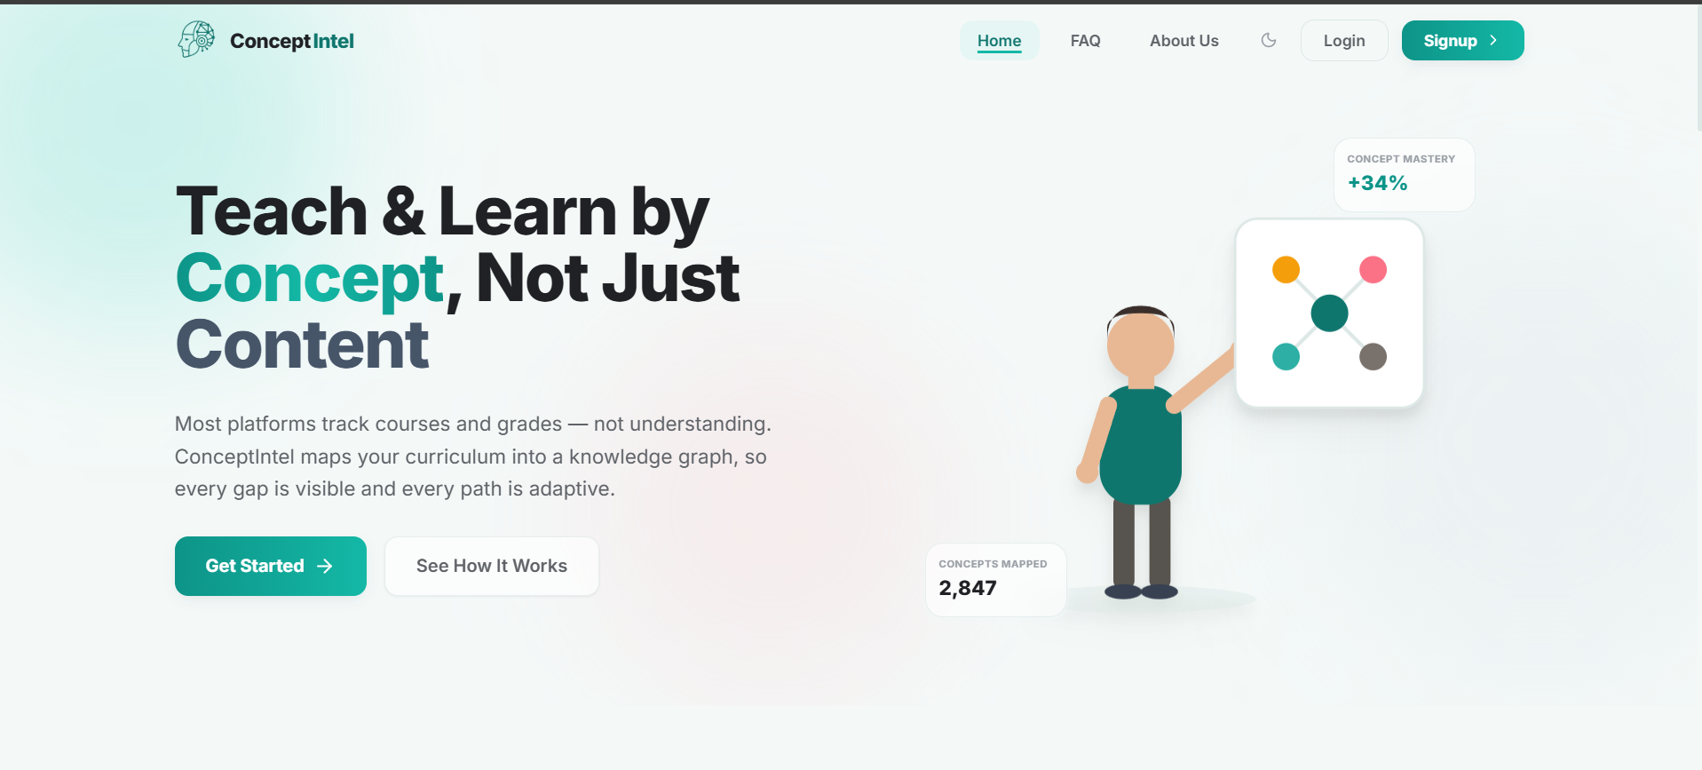

ConceptIntel;
A knowledge graph-based concept intelligence platform for teachers & students
The AI That Finally Teaches Universities What Their Students Don't Understand; Concept by Concept.
"Today's platforms grade the answer. ConceptIntel understands the gap."
Air University, Islamabad
Mamoona , Laiba , Muhammad Kashif
Supervisor: Assistant Professor (Dr. Sumaira Farid)
1

Slide 2






Product Snapshot
Product introduction
ConceptIntel serves university teachers and students in prerequisite-heavy STEM courses. Students never know which concept is weak — they only get a score. Teachers never know which concept the whole class lacks, with no time to give concept-level feedback to every student. ConceptIntel builds a prerequisite knowledge graph, generates targeted content per concept, and its adaptive engine routes each student to what they're missing; teacher-reviewed first.
Innovation
Our single most innovative capability is the two-stage human-approval workflow for AI-generated knowledge graphs: AI proposes concepts and prerequisites, a teacher edits them, and a coordinator signs off before anything reaches a student. No alternative does this. Classroom and Coursera have no knowledge graph at all; Khan Academy's content is fixed and teacher-uneditable; ChatGPT generates answers with no approval gate whatsoever.
Quality control
No formal certifications yet — this is an academic prototype. Our compliance evidence is architectural: role-based access across 5 tiers, JWT authentication, AI content sandboxed under a strict CSP, and full AI-call tracing via Langfuse. Every AI answer, including assignment feedback, is grounded through RAG with mandatory citations so nothing is generated ungrounded
CORE QUALIFICATION FIELDS
Founded in
Feb 2026; Air University FYP
Launched in
Prototype — pilot-ready
Number of Clients
0 paying; 3 subjects validated
IP Owned
Partial — pending FYP IP-policy confirmation
Business Model
SaaS — per-institution license
₨
Revenue
Pre-revenue (FYP prototype)
Most Innovative Feature
Human-approved AI knowledge graph
✓
Licenses / Certifications
None formal — aligned to HEC CLO/PLO standards
Validated beyond the classroom — positive feedback from IEEE reviewer, our department HOD, and a professor from MBZUAI.

Slide 3




Why is your product ready for the P@SHA ICT Awards?
We are ready because we replace one-size-fits-all courseware with a governed AI knowledge graph, proven by three real university subjects tracked end-to-end, supported by human approval gates and a hallucination-mitigation RAG pipeline, and scalable to every university that needs this.
Uniqueness
The only platform with a teacher-editable knowledge graph — Classroom, Coursera, and ChatGPT map no concepts or prerequisites at all.
A teacher's own slides become a live, shared graph in minutes, not a fixed curriculum built by someone else.
Market Potential
Target market: every HEC university with prerequisite-heavy STEM courses, starting with our own CS and Engineering departments. Business model: per-institution SaaS, layered on top of the LMS a university already pays for. Growth: each knowledge graph is reused every semester — the second and third cohort onboard almost for free.
1
2
Functionalities & Features
Full pipeline, live end-to-end: upload with OCR, concept extraction, teacher and coordinator review, adaptive learning. Concept-level grading, mastery heatmaps, per-concept mini-games — not just a percentage score. Built on standard formats already in use: PDFs, PPTs, and HEC-format CLOs and PLOs.
4
Quality & Technology
Content & standards: a hallucination-mitigation layer — grounded RAG, calibrated thresholds, mandatory citations, full Langfuse tracing. Stability & reliability: FastAPI, pgvector, Neo4j Aura, and a 3-provider LLM fallback so the assistant never hard-fails. Security: 5-tier RBAC, JWT auth, and CSP-sandboxed AI content.
3
Make screening easy
Proof points: prerequisite chain proven end-to-end, Applied Physics to Digital Logic Design, praised by IEEE, our HOD, and MBZUAI (impact). Two-stage human-approval gate that no alternative offers (innovation). A dedicated hallucination-mitigation layer (technology/quality).

